Slide 1
Can We Predict
41.43%
Churn Rate
5.59 Cr / year
Revenue at risk
10,357 customers churned
Avg ARPU: ₹450/month
Who Leaves
Before They Go?
ConnectTel Communications Ltd
Dataset: 25,000 customers | 36 Features | 5 Models Evaluated

Slide 2
The Problem We Are Solving
“ConnectTel Communications Ltd” - a pan-India telecom operator - is experiencing a significant and sustained increase in customer churn. This customer attrition is negatively affecting the company’s revenue, market position, and future expansion.
01
02
03
Reactive Only
Customers are engaged ONLY after they initiate port-out or disconnection requests. No proactive system exists.
Silent Churn
High-value customers leave without explicit complaints or warning signals, making detection extremely difficult.
Data Blind Spot
No systematic use of the 36 available behavioral, billing and service features to predict churn before it happens.

Slide 3
Dataset Overview
25000
Customer Records
36
Columns
0
Missing Values
41.43%
Churn rate
Demographics & Plan
Usage & Billing
Service Experience
Payment & Competitor
Age, Gender, Region Circle.
Connection Type (4G, 5G, Fiber).
Plan Type (Prepaid / Postpaid)
Contract Type, Tenure.
Monthly & Total Charges.
Avg Data (GB/Month)
Voice Minutes, SMS Count.
Overage Charges, ARPU
Network Issues, Dropped Call Rate.
Complaints Count (3m, 12m).
Resolution Time (Days).
Service and NPS Rating.
Auto Pay
Payment Delays (Days)
Competitor Offer received.

Slide 4
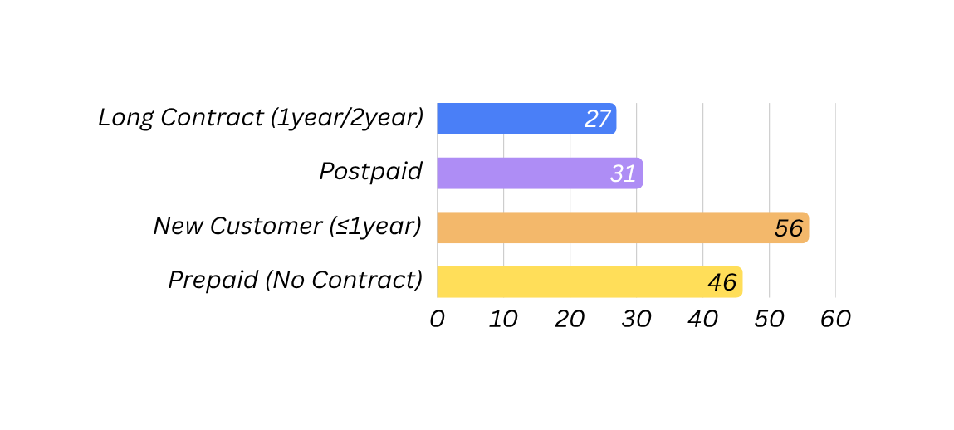
What the Data Told Us – EDA Highlights
Churn Rate by Segment (%)
Prepaid Plan
70% customers
Highest Churn Segment
No Contract
17522 Customers
No commitment – Easy exit
Users
4G: 51.1% of customer base
5G: 30% of customer base
Better network – more stable
Postpaid Plan
29.9% customers
More loyal – Lower churn
Tenure
Avg tenure = 60 months
Fairly stable long - term customer base
Monthly Charges
Avg charge = ₹475/month
High variation (₹99/- – ₹1603/-)
New Customer Vulnerability
Customers within 12 months churn 2x faster. Onboarding is critical
📊 NPS Average = 20
Low, ‘okay’ customers are easy to lose. Strong churn predictor.
⭐Service Rating = 3.8 / 5
Insufficient satisfaction across base.
💳20% Late Payers
Only 40% on autopay = weak behavioral commitment.
📱 ~8 logins/month
Low engagement. Self -care transactions ~2 per month

Slide 5
Model Building Methodology
01
Data Loading & EDA
25,000 records, 36 columns. No missing values. Churned: 41.43% customers (10357) & Retained: 58.57% (14643).
04
Encoding & Scaling
OneHotEncoder for 7 categorical features.
Robust scaler for numerics (outlier-resistant).
02
Feature Engineering
9 business driven features created, arpu & tenure months dropped from model. arpu due to multicollinearity and tenure converted into derived feature.
05
Model Training (5 Models)
GridSearchCV + 5-Fold Stratified cross-validation
Optimization metric: Recall (churn class).
03
Train-Test Split
80/20 stratified split.
Train: 20,000 | Test: 5000
stratify=y ensures data balance preserved.
06
Threshold Tuning
Precision-Recall curve used
Best Threshold 0.4154 → not recommended for deployment (too many false positives).

Slide 6
Feature Engineering - 9 Business driven Features
9 new features were engineered to capture hidden behavioral patterns that raw data cannot express directly.
Feature Name | Business Rationale | Insight
high_data_consumption_flag | Top 25% data users. Heavy users are revenue critical. | Premium Retention Priority.
high_voice_usage_flag | Top 25% voice users. Identifies heavy engagement segment. | Cross-sell opportunity.
low_usage_flag | Bottom 25% in BOTH data and voice usage. Low engagement. | Engagement campaign.
lifecycle_stage | New(<= 12m) / Early(13-24m) / Mature(25-60m) / Loyal(>60m) | Lifecycle specific strategies
poor_complaint_handling | Recent complaints + resolution_time > 2 days. Service failure + inefficiency. | Trigger urgent escalation.
new_customer_high_risk | tenure <= 12 months & plan type = prepaid. | New customer with prepaid plan indicates churn risk.
nps_category | Detractor (nps_score < 0) / Passive (0 - 50) / Promoter(score > 50) | Convert subjective feedback to structured churn predictor.
low_service_rating | Bottom 25% service rating. | Dissatisfaction and high-churn prob.
plan_fit_score | Inverse of the ratio of overage charges to monthly charges. | Low score - Customers frequently pays extra - poor-plan fit.

Slide 7
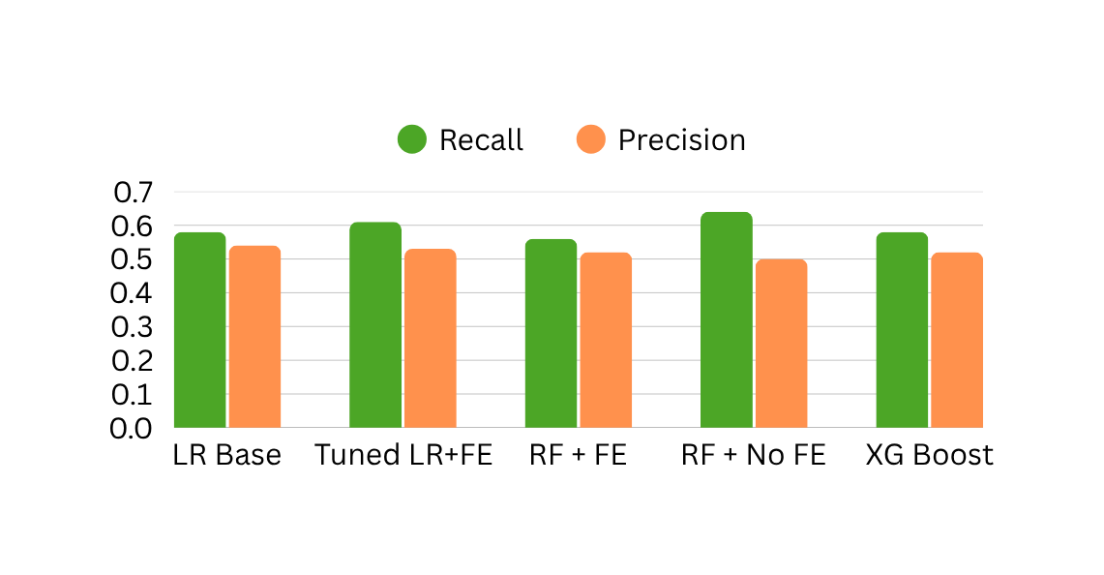
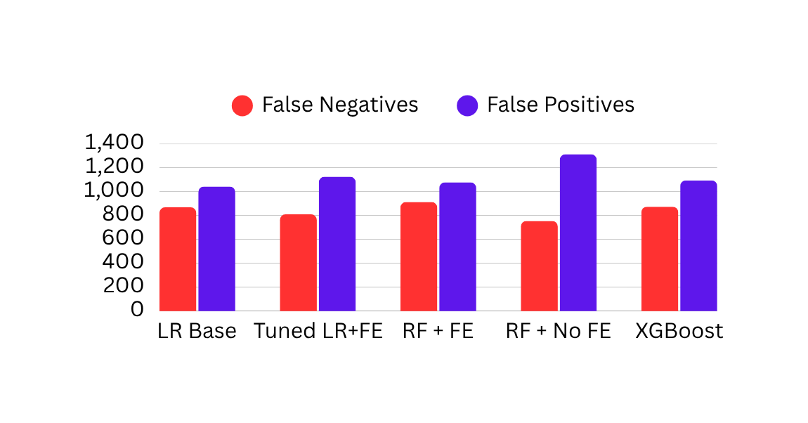
Model Comparison - Performance Metrics
Recall Vs Precision Comparison
FN vs FP Count
Model | Precision | Recall | F1 | ROC-AUC | FN | FP
Baseline LR (with FE) | 0.54 | 0.58 | 0.56 | 0.661 | 868 | 1042
Tuned LR (with FE) (Selected) | 0.53 | 0.61 | 0.57 | 0.659 | 809 | 1124
Random Forest (with FE) | 0.52 | 0.56 | 0.54 | 0.637 | 912 | 1077
Random Forest (without FE) | 0.50 | 0.64 | 0.56 | 0.639 | 754 | 1312
XG Boost (without FE) | 0.52 | 0.58 | 0.55 | 0.655 | 873 | 1094

Slide 8
Final Model – Tuned Logistic Regression (with FE)
🏆 SELECTED MODEL: Tuned Logistic Regression with Feature Engineering
Best Params: C=0.01 | Penalty=l1 | solver=liblinear | class_weight=balanced | Best cv Recall=0.6288
0.61
Recall (Churn)
0.53
Precision (Churn)
0.57
F1 Score (Churn)
0.6595
AUC ROC
809
False Negatives
1124
False Positives
Segment Wise Performance
Segment | Model | Precision | Recall | Model | Precision | Recall
Low Value | LR (with FE) | 0.53 | 0.74 | RF (no FE) | 0.49 | 0.83
Medium Value | LR (with FE) | 0.54 | 0.52 | RF (no FE) | 0.53 | 0.48
High Value | LR (with FE) | 0.46 | 0.17 | RF (no FE) | 1.0 | 0.02

Slide 9
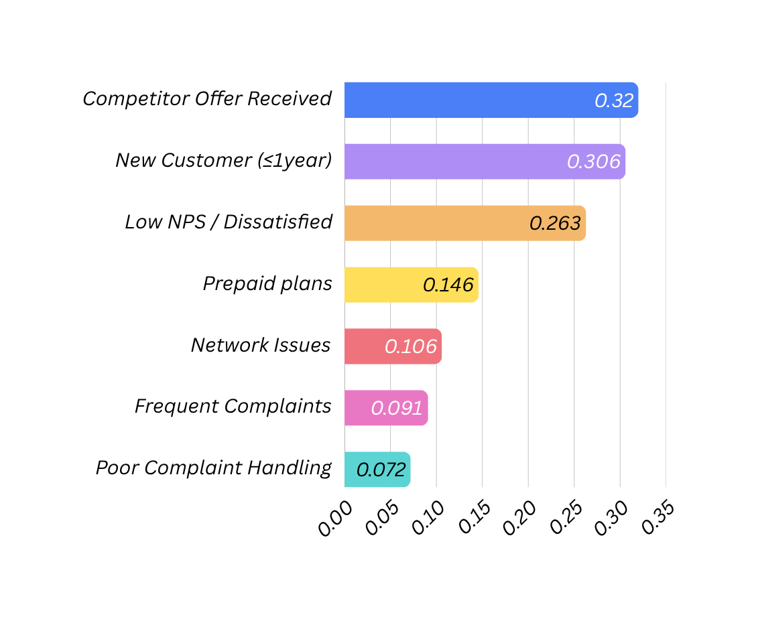
Churn Drivers & Threshold Tuning Analysis
Top Churn Drivers (LR Coefficient)
Top Retention Signals
High Service Rating & NPS Score
Postpaid Plan Subscribers
Long Tenure (> 24 Months) / High Total Charges
Threshold Tuning result: Best threshold = 0.4154 ⟶ Recall jumps to 0.86 BUT Precision drops to 0.47, causing excessive false positives, NOT deployed. Default threshold (0.5) used with recall = 0.61.

Slide 10
Strategic Recommendations
A
Deploy as Decision-Support in CRM
Integrate model for monthly/weekly scoring AUC=0.66 supports decision making, not full automation. Business judgement remains essential
B
Risk Based Customer Tiering
Critical(>0.60): Aggressive personal outreach, high-value discounts. High(0.50-0.60): Strong offers + complaint resolution. Medium (0.45-0.50): Emails, loyalty rewards. Low (<0.45): No action.
C
Top-N Targeting for High-Value Segment
Model recall for high-value is only 17%. Use top-30% probability ranking within high-value segment. 43.18% churn density vs 31.35% overall ⟶ higher ROI per campaign rupee.
D
Address Root Cause Churn Drivers
Counter competitor offers proactively. Fix onboarding for new customers (≤12m). Reduce complaint resolution time (<2days). Upgrade network quality.

Slide 11
Business Impact Quantification
10,357
Actual Churners
₹ 450/month
Average ARPU (churned)
₹ 5.59 Cr
Annual Revenue at Risk
6,317
Churners Identified by Model (61% Recall)
2,210
Retained (35% Conservative Rate)
₹ 1.19 Cr
Annual Revenue Saved
Revenue Risk Mitigated: 21.34% | ₹1.19 Cr saved from ₹5.59Cr at risk | Retention rate: 35% (conservative rate assumed)
Top N Targeting Strategy – For High-Value Segment (Test Set Results)
Target Group | Customers Targeted | Churn Captured | Churn Rate (%)
Top 30% (Recommended) | 176 | 76 | 43.18
Top 50% | 293 | 111 | 37.18
All Customers | 587 | 184 | 31.35

Slide 12
Conclusion & Key Takeaways
🎯
Churn is Predictable
Tuned LR (FE) achieves Recall=0.61 identifying 6,317 out of 10,357 churners for targeted intervention.
💡
Root Cause are Clear
Competitor offers, weak onboarding (<12m), and low NPS are the top 3 churn triggers – all addressable.
🏆
Model Selected Correctly
Tuned LR beats RF on segment precision, false positives control, and business explainability.
🔬
Data – Constrained
AUC=0.66 reflects dataset limits, not model failure, Even XGBoost shows similar performance.
🚀
Clear Path Forward
Richer data signals + quarterly refresh = significant future improvement.
💰
Financial Impact Proven
₹1.19 Cr saved annually from ₹5.59 Cr at risk = 21.34% revenue risk mitigated.
Thank You

